Slide 1

NARASARAOPETA ENGINEERING COLLEGE (AUTONOMOUS) T
PREDICTING THE VALUE OF FOOTBALL PLAYERS
under the esteemed Guidance of
Mr. m. Sathyam Reddy (MTech)
By
GOLI BODHINI(19471A05L6)
KANDULA VENGAMAMBA(19471A05M4)
VALLURI SREEVANI (20475A0509)

Slide 2
CONTENTS
Abstract
Existing System
Proposed System
Literature Survey
Algorithm
Requirements
Output Screens
Conclusion

Slide 3
ABSTRACT
As we all know that football is a very popular and trending game across the Globe, and the football players like Christiano Ronaldo, Lionel Messi, Mbappi are become very popular in recent games. We all know their names and Origin of these famous football players and many of us don’t know their net value. In this project we are going to predict every foot ball player using Machine Learning. In Machine learning we are going to use four algorithms or features namely linear regression, multiple linear regression, decision trees and random forests.

Slide 4
EXISTING SYSTEM
Previously, decisions are made by agents and experts based on their experience and knowledge.This practice may lead to errors, consume a lot of time and excessive costs which affects the value of football players.
1.Doesn’t generate accurate and efficient results.
2.Computation time is very high.
3.Lacking of accuracy may result in lack of value of football players.

Slide 5
PROPOSED SYSTEM
By using these algorithms we can reduce the complexity in predicting the value the football players, reduce errors, enhance accurate results. It is easier to predict the value and it will also help the club agents to make quick decisions.
Advantages:
1.Generates accurate and efficient results.
2.Computation time is greatly reduced.
3.Reduces manual work.
4.Efficient and accurate results.

Slide 6
LITERATURE SURVEY
Machine learning is an application of artificial intelligence (AI) that provides systems the ability to automatically learn and improve from experience without being explicitly programmed. Machine learning focuses on the development of computer programs that can access data and use it learn for themselves.
Here, we are using FIFA data set provided that was shared by the Kaggle which it contains 17,980 cases and each case says about the individual football player.
For analysis and to determine the value of football player we are using certain algorithms namely, i) Linear Regression ii)Multiple Linear Regression iii)Regression Tree and iv)Random Forests

Slide 7
The most common indicators for assessing the market value fall into three categories:
1)player characteristics
2)player performance and
3) player popularity.
1)Player Characterstics: It playes an important role in determining the value of football player.For example, height is a significant charcterstic. If the height of the player is more, it will help in preventing the goals.

Slide 8
2) Player Performance:
Goals,refer to players’ ability to score.
Passing are used frequently.
yellow and red cards
All these above factors are useful in prediciting the value of football players.
3)Player Popularity:
The popularity also can explain the demand for football players.
In other words, the market value of football players also depends on their crowd pulling power, independent of what they show on the pitch.

Slide 9
ALGORITHMS

Slide 10
Linear Regression
Linear Regression is a machine learning algorithm based on supervised learning. It is mostly used for finding out the relationship between variables and forecasting.
Linear regression is used in many different fields, including finance, economics, and psychology, to understand and predict the behavior of a particular variable. For example, in finance, linear regression might be used to understand the relationship between a company’s stock price and its earnings, or to predict the future value of a currency based on its past performance.
Linear regression performs the task to predict a dependent variable value (y) based on a given independent variable (x)). Hence, the name is Linear Regression.

Slide 11
Multiple Linear Regression
The multiple linear regression model is an improvement on the baseline model(Linear Regression) with an RMSE(Root Mean Square Equation).
From our analysis, the player position and most player attributes such as international reputation, potential, height and age are statistically insignificant for predicting player value.

Slide 12
DECISION Tree
Decision Tree is the most powerful and popular tool for classification and prediction.
A Decision tree is a flowchart-like tree structure, where each internal node denotes a test on an attribute, each branch represents an outcome of the test, and each leaf node (terminal node) holds a class label.
A tree can be “learned” by splitting the source set into subsets based on an attribute value test. This process is repeated on each derived subset in a recursive manner called recursive partitioning.
Decision trees can handle high-dimensional data.

Slide 13
Random forest regression
Random Forest is an ensemble of decision trees. Many trees constructed in a certain ‘random’ way, form a Random Forest. It also provided a significant improvement over baseline model with an RMSE and R-Squared model.
This means Random forest regression is a powerful generalization of the linear regression and for Regression trees.
Random Forest Regression, like, Regression trees, also does a better job when compared with other algorithms.

Slide 14
Requirements
Software Requirements
Hardware requirements
Browser: Any latest version like Chrome
Operating System: Windows 10
Language: Python
Platform: GoogleCOLAB
Processor: Intel Core 2i7-5500U CPU @250GHz
RAM: 8GB(GigaByte)
System Type: 64-bit operating system, x64-based processor

Slide 15
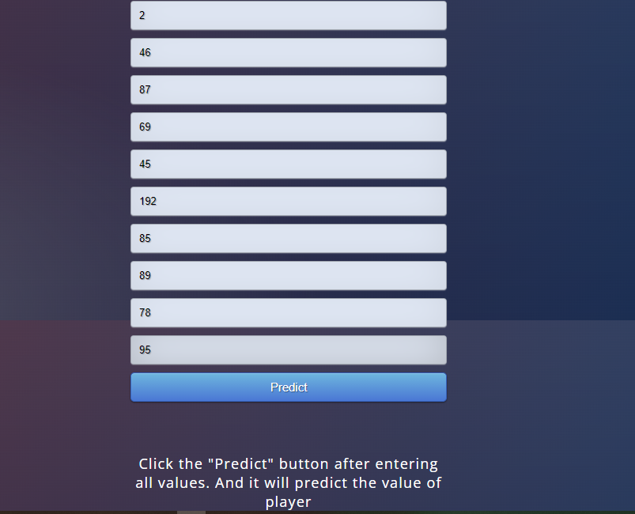
OUTPUT SCREENS

Slide 16


Slide 17
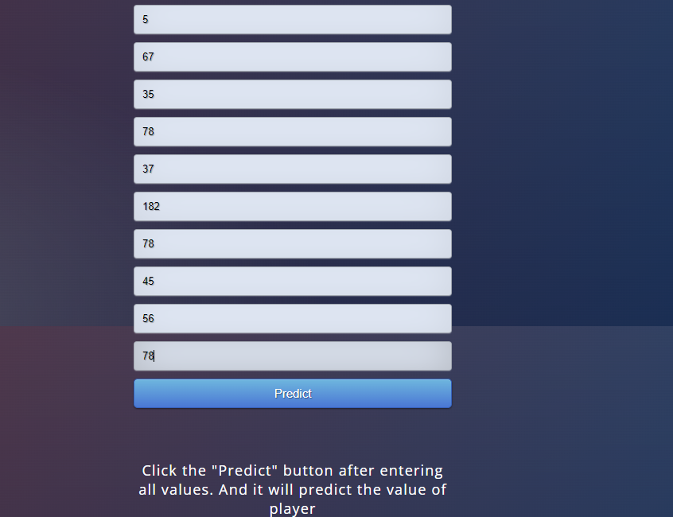

Slide 18


Slide 19
CONCLUSION
We have used algorithms like Linear Regression, Decision Trees, Random Forest in- order to predict the value of football players. The accuracy varies for different algorithms. The accuracy for Linear Regression algorithm is 61.06. The accuracy of Random Forest algorithm is 99.9 when correlation are applied. The highest accuracy for Decision trees algorithm is 99.6%. Hence, we conclude Random forest is the best suitable algorithm.

Slide 20


